Slide 1
Stimulus Presentation
Created by: Team #9

Slide 2
Rules
There are a total of 6 pairs of images
Each Image will be tested 10 times
NOTE: Try not to move. If you must move or shift during the test make sure it is during the wait or the image slides.

Slide 3



Slide 4


Slide 5


Slide 6
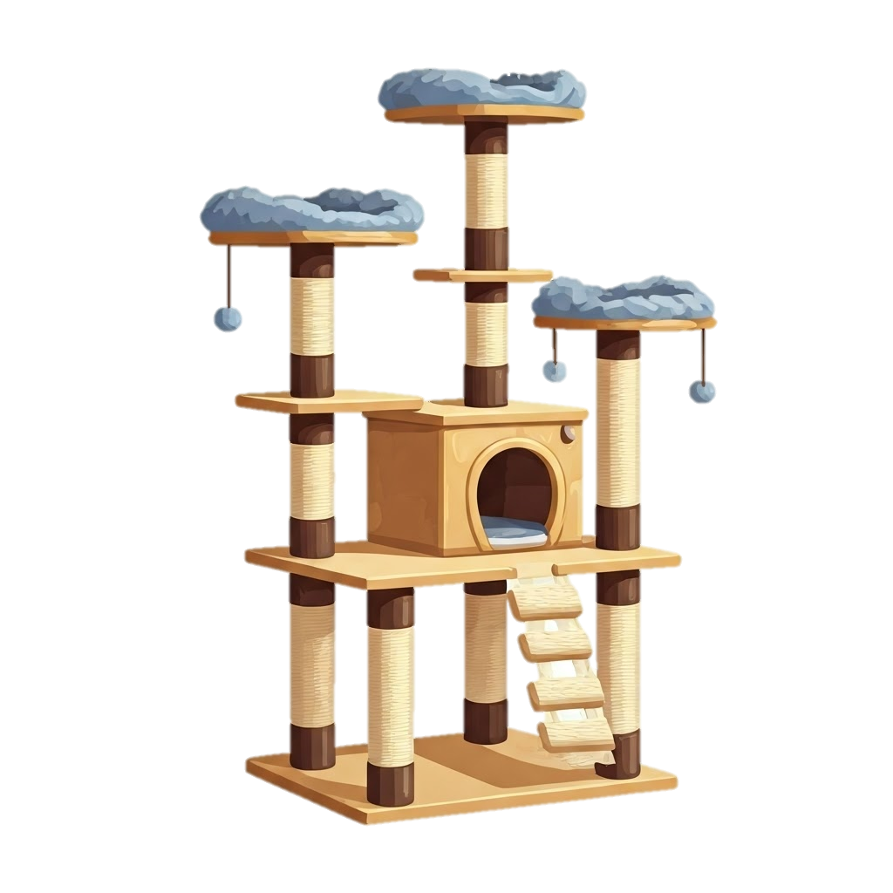


Slide 7

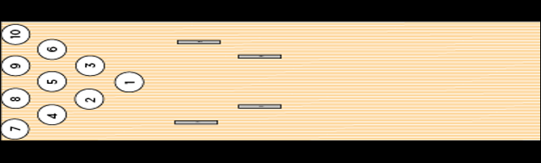


Slide 8


Slide 10


Slide 11


Slide 12


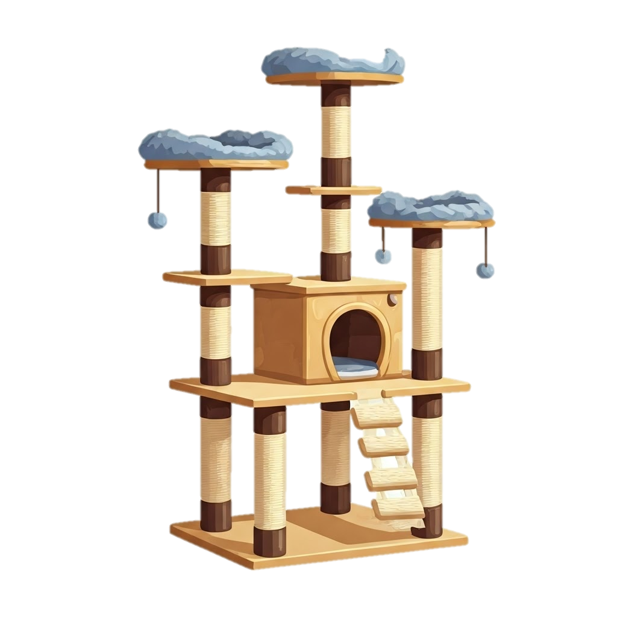

Slide 13


Slide 15
Wait

Slide 16
Notes:
Slide for data recording portion. LEAVE BLANK

